Slide 1
SAE Architecture
Mobile Computing Presentation

Slide 2
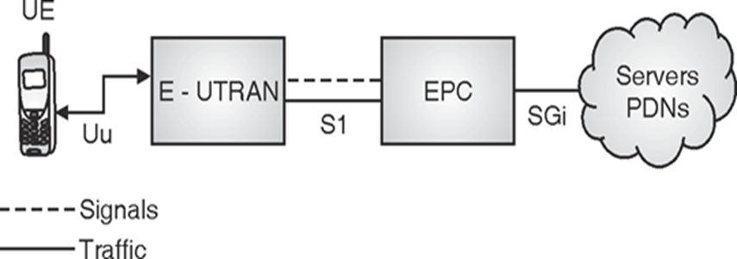
High Level Network Architecture

Slide 3
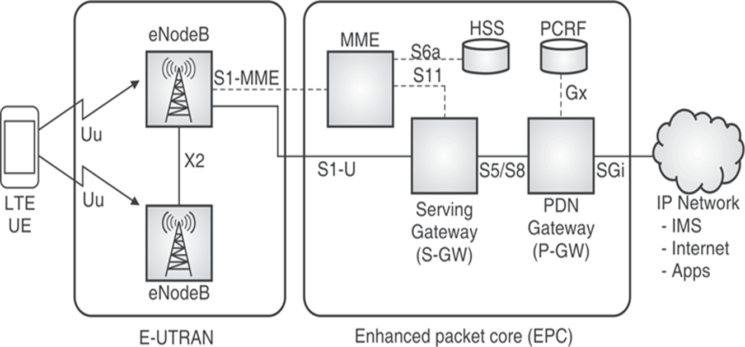
SAE Architecture

Slide 4
Thank You!

